Slide 1




High-Level Symbolic Representation (HLSR)
Thinking…
…inside the box
Soar Workshop Presentation
Presented on 10 June 2004 by
Jacob Crossman
Development Team: Jacob Crossman, Robert Wray PhD, Christian Lebiere PhD
Project Manager: Al Wallace
Developed under funding from the Defense Modeling and Simulation Office (DMSO) Contract F33615-03-C-6343

Slide 2
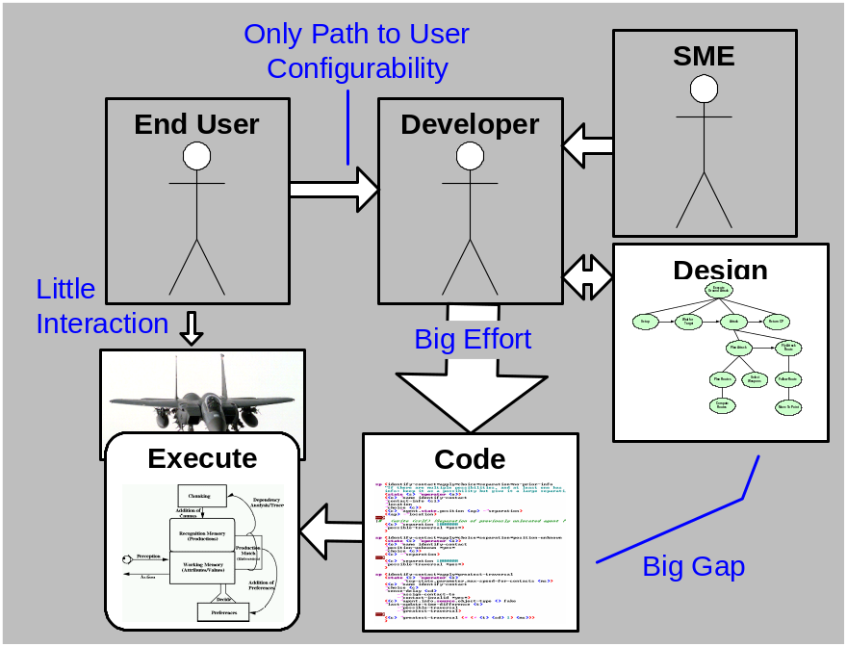
Behavior Development Challenges
Errors introduced at each translation
End user must ask developer to make changes
Result: Behavior is not as complete as desired
Design concepts lost when mapping design to code
Significant effort required for rich, complex behavior
Challenging to reuse behavior elements from one application in another
Little behavior code and design reuse across architecture
Critical for efficient and tractable development of large scale intelligent systems
Notes:
Why?
Intelligent systems are complex with high degrees of dependency and coupling between knowledge and a lot of runtime flexibility
Design doesn’t map directly or completely to code (architecture terms and concepts at a much lower level than the design)
End user must go through the developer to configure behavior (costly and prone to errors)
Lots of details that have to be managed by developer
Summary, the challenge we are trying to solve is making it easier to specify and maintain intelligent systems, especially large intelligent systems.

Slide 3
Common Problems and Patterns in Behavior Development
Problem/Pattern | Description
Process tagging | “Process done” and “process status” tags
Knowledge Integration | Integrating knowledge from different models, representations, and ontologies
Retrieve v. Compute | Execute a process or retrieve previously computed answer?
Iteration | Process a series of objects in some order while not losing reactivity
Copying | Creating copy of object
Complex Logic | Using logic axioms to simulate missing logical primitives (e.g. “or”)
Sensory/Motor Interactions | Ad hoc, incomplete, and inconsistent implementations of sensory and motor interactions

Slide 4
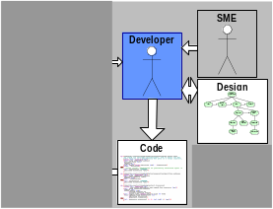
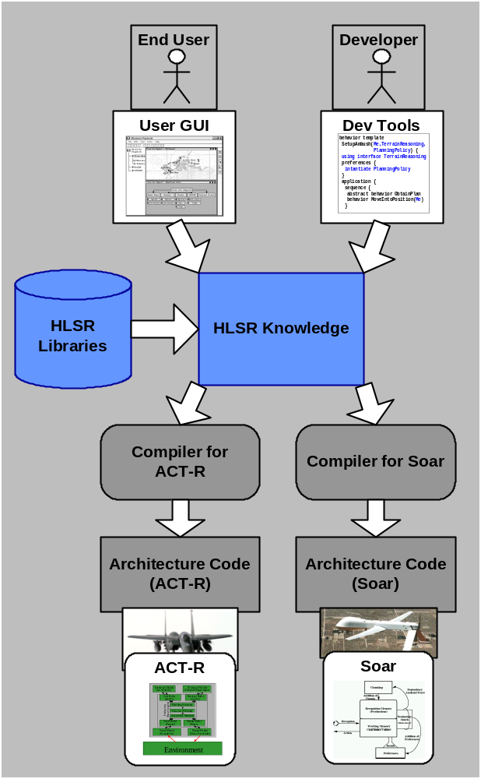
What is HLSR?
High Level Symbolic Representation
A language for knowledge encoding
The language is:
  Architecture independent
  Domain independent
  High-level
  Designed to support reuse
Target users:
  Behavior developer
  End user tool developers

Slide 5
Why a language?
Better tools are necessary but not sufficient
  Tools need appropriate architecture abstractions
  Each tool tends to have its own custom built abstraction
  Tools tend to have ad hoc and incomplete translation processes from abstraction to architecture
  A language formalizes and generalizes the architecture abstraction
Better cognitive architectures are necessary but not sufficient
  Architectures are works in progress
  Architecture languages are cognitive “assembly languages”
    Emphasize efficiency, runtime flexibility, control, and fidelity to human behavior
    Do NOT emphasize SE goals like understandability, maintainability, and reuse
  A language allows merging of different architectural concepts while abstracting low-level details

Slide 6
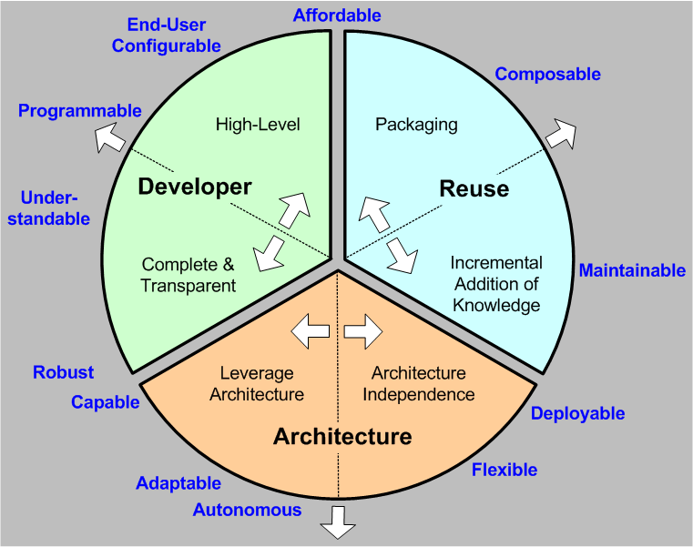
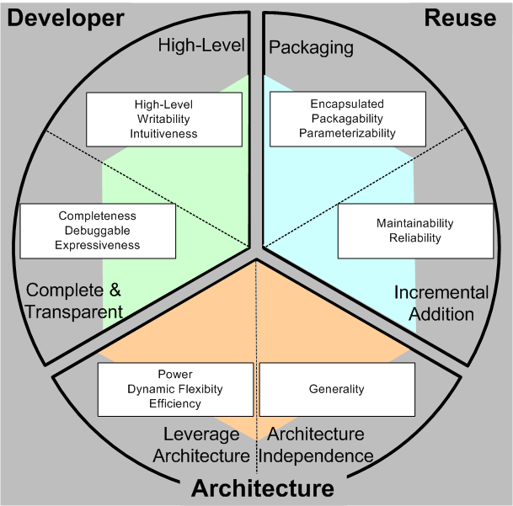
HLSR Requirements
Balancing the requirements – a goal of HLSR
Competition between and within categories
  Meeting all requirements fully appears impossible
  HLSR seeks a balanced solution
Evaluation metrics help measure success

Slide 7
Approach
To achieve architecture requirements:
  Unify representation of common features
  Give architecture large degree of discretion in how it interprets and executes the knowledge
To achieve developer requirements: Build solutions to catalog problems into HLSR
To achieve reuse requirements: Borrow and adapt concepts of encapsulation and interfaces from SE

Slide 8
Common Themes I: Architecture Commonality
Cognitive and agent architectures share many similar concepts (even if terminology is different)
  Directly supported classes of knowledge representations
    Beliefs, assertions, chunks
    Goals, intentions
    Productions, operators, transforms, plans
    Preferences
  Knowledge states
    Asserted, not-asserted
    Candidate, selected, was selected
  Decision making processes
    Least commitment
    Goal driven reasoning
    Conflict resolution

Slide 9
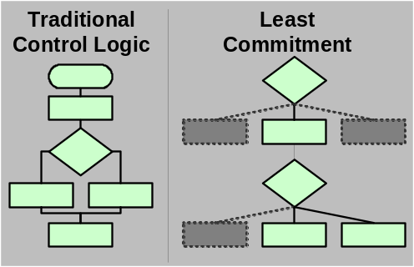
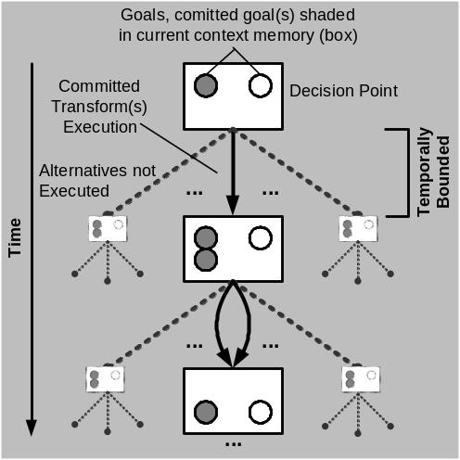
Common Themes II: Balance reactivity and deliberation
Least Commitment to Execution Path
Goal Driven Behavior
Fixed start
Decision Process
Decisions local and static
Take best action for context
Desired state
Follow Least Commitment Pattern
Focus retained through goals
Constraints lead to responsiveness

Slide 10
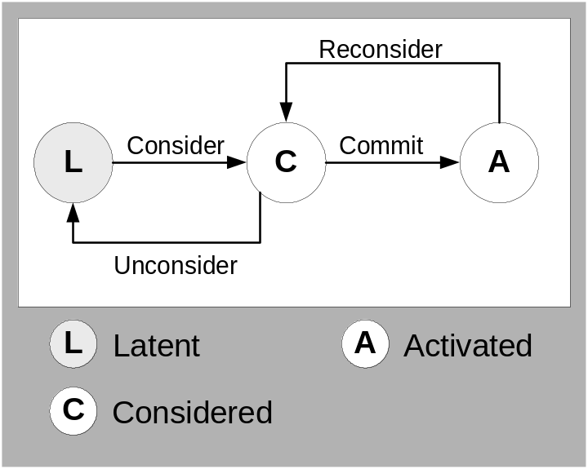
Common Themes III:
Knowledge states (CCRU)
Definition: All objects – goals, transforms, beliefs – are in one of four states, and can move between these three states only through the transformations consider, commit, reconsider, unconsider (CCRU)
The activated state has special semantics that depend on the type of object being activated
Object | Activated Semantics
Goal | Candidate for transform
Transform | Executes
Belief | Is believed
Production Set | Productions can fire

Slide 11
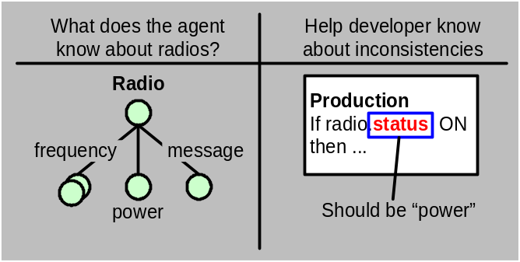
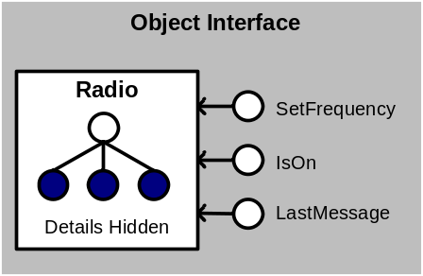
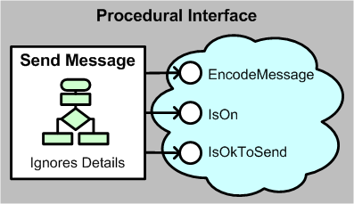
Encapsulation and Interfaces
Explicitly declare intention: aid understandability and abstraction
  Types and structure
  Procedure constraints (e.g. sequences)
Hide details: reduce coupling
  Data encapsulation
  Process encapsulation
Define interactions: simplify reuse
  Parameter lists
  Object Interfaces
  Procedure/Callback Interfaces

Slide 12
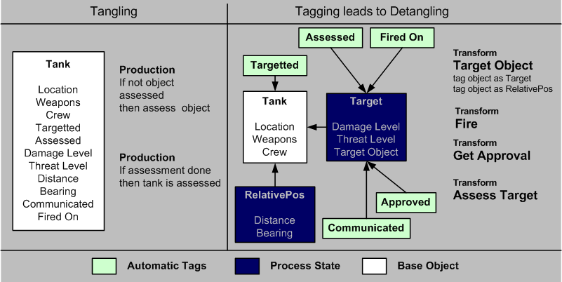
Catalog Solutions: Tagging
Tags encapsulate process-specific state

Slide 13
Common Problems: Solutions
Problem/Pattern | HLSR Solution
Process tagging | Auto-tagging, tag primitives, abstraction
Knowledge Integration | Architecture independent language, support for types, XML based representation
Retrieve v. Compute | Abstraction, still needs work
Iteration | Iteration primitives, architecture expansion
Copying | Sensed object internalizing
Complex Logic | Constrained logic blocks, named queries, “or”
Sensory/Motor Interactions | Extended CCRU for “sensed” objects, standard output command objects, behavior primitives
Significant steps toward simplification
Still some areas that need more work

Slide 14
Primitives – Core HLSR Primitive Constructs
Construct | Form | Responsibility
Reactivity
Activator | Production (rule) | Reactive consideration
Terminator | Production (rule) | Reactive reconsideration
Goal-driven Process
Goal | Object w. achieve knowledge | Explicitly represent desired state
Preference | Production (rule) | Context based hints/choice
Transform | Object w. execution body | Constrained CCRU actions
Encapsulation and Packaging
Belief | Object | Represent belief
Interface | Collection of queries and manipulators | Decouple objects and procedures
Manipulator | Named transform fragment | Encapsulate related actions
Production Set | Object w. productions | Shared context for productions
Query | Named LHS condition | Encapsulate condition

Slide 15
Compiling to Target Architectures
Requirements
  Translate a (source) program written in HLSR to either ACT-R or Soar (object) languages
Challenges
  Architecture independence may require an HLSR “virtual machine” level within each target architecture
  Architecture discretion allows many possible HLSR-compliant compilers for each target architecture (speed, space, fidelity trade-offs)

Slide 16
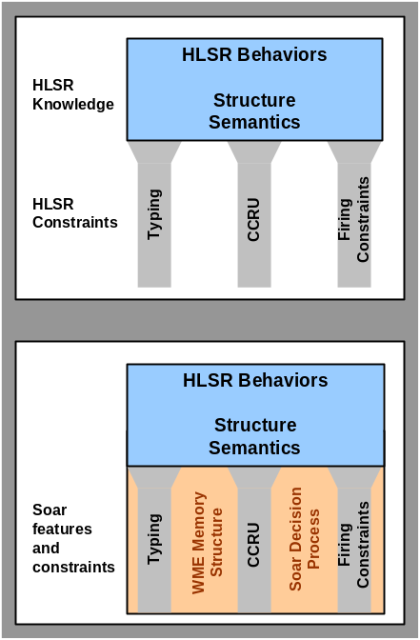
Architecture Discretion
If something is not defined at the HLSR level, it is up to the compiler and architecture to define it
Specific Compiler/Architecture Decisions
Memory and object structure
Retrieval process and strategy
Default commit/unconsider process
Decision process
Error handling process
Learning process
Sensory/Motor System
HLSR constraints
Architecture discretion
Decisions for specific architecture and compiler
Impact: behavior will be different on different architectures, and using different compilers

Slide 17
Micro Theories and Templates
Soar compiler is a combination of
  Micro-theories
  Code templates
  Runtime library
Micro-theory: mappings from HLSR to Soar (and ACT-R) architecture processes and representations. Must cover:
  HLSR constructs, processes, and constraints
  Areas of architecture discretion
Code Templates: productions, portions of which were filled in based on HLSR code
Runtime Library: productions and operators that managed HLSR constructs and processes

Slide 18
Mapping HLSR to ACT-R and Soar
R: Representation
A: Means of
activation
HLSR Construct | Mapping to ACT-R | Mapping to Soar
Activator / Terminator | R: ACT-R Production Rule A: Conflict Resolution Cycle | R: Soar Production A: JTMS
Belief | R: Declarative Memory Chunk A: Buffer Creation + Spread. Act. | R: Declarative Memory A: Decision Cycle (DC)
Goal | R: Goal Buffer + Declarative Mem. A: Production Rule + Retrieval | R: Declarative Memory A: Decision Cycle
Manipulator | R: Production Rules + Commands A: Conflict Resolution + Buffer | R: Soar operator A: Decision cycle
Preference | R: Production Utilities A: Conflict Resolution Cycle | R: Soar Productions A: Decision Cycle + Learning
Production Set | R: Type-Specific Production Set A: Conflict Resolution | R: Decl Mem (problem space) A: Decision Cycle
Query | R: Sequence of Retrievals/Tests A: Conflict Resolution Cycles | R: Soar elaboration A: JTMS
Transform | R: Set of Production Rules A: Conflict Resolution Cycles | R: Declarative Memory A: Multiple Decision Cycles

Slide 19
Preliminary Results for HLSR2Soar
 | Prods | CPU (msec) | Decision Cycles | Assertion Cycles | Prod Firings | Memory Changes
Regular Soar Agent | 27 | 140 | 7 | 15 | 23 | 120
HLSR2 Soar | 142 | 752 | 21 | 97 | 231 | 584
HLSR2 Soar (repeat) | 149 | 551 | 13 | 66 | 144 | 300
HLSR2 Soar (different response) | 151 | 651 | 18 | 82 | 176 | 420

Slide 20
Progress and Successes
Implementation
  Proof of concept compilation
    Have hand-compiled example
    Automatic compiler for subset of HLSR to Soar
  Have complete HLSR draft specification
Research
  CCRU as
    a unifying principle AND
    a basis for architecture independent primitive operations
  Abstraction of details
    HLSR helps solve some catalog problems
    Compiler handles repetitive and error prone tasks
  Added structure and constraints that map well to design
    Explicit goals, transforms, and preferences
    Typing and encapsulation of data

Slide 21
Lessons Learned
Architecture Related
  Architectures have more in common than expected – more work that crosses architecture boundaries is welcome
  Working at HLSR level causes architecture “quirks” to be highlighted – developer no longer wants to deal with these
  It is difficult to go up to higher levels of abstraction and retain architecture leveraging – still a work in progress
  Improved learning will probably be needed for efficiency and knowledge integration
Knowledge Engineering Related
  It is possible to balance engineering and architecture requirements – specifically encapsulation and runtime flexibility

Slide 22
Open Research and Future Work
Research Issues
  Learning:
    When and how to integrate learning
    How to integrate learning back into HLSR
  Some constructs difficult to compile and we don’t yet know the “best” approach
  Compiler optimization
  Don’t understand ramifications (or implications) of architecture discretion
Future Work
  Building a full-scale compiler
  Testing in a large scale application
  Testing with other intelligent system architectures
  Libraries: we have the start, but need more

Slide 23
Backup

Slide 24
What’s unique about HLSR?
We do not want to program intelligent systems – we want to constrain them
Blend of reactivity and goal-driven process
Abstraction across cognitive architectures: many more differences than computer architectures
Emphasis on flexibility in program flow and internal structure

Slide 25
Evaluation Metrics
We choose metrics for each slice
Evaluation process
  Team scores of each construct/constraint
  Team scores representation as a whole
  Combining scores TBD
Goal:
  Balance
  Maximized capability

